Slide 1
Personalized Cancer Medication Prediction with Deep Learning on Mutation Datasets
By Gopalakrishnan Kumar, MTech IIT-Bombay,
Data Analyst/ Scientist
LinkedIn: Profile Link : https://www.linkedin.com/in/gopalakrishnankumar-a73301110/
Github:https://github.com/Gopal21236/
Kaggle URL- https://www.kaggle.com/gopalkk2

Slide 2
Google Colab URL
https://colab.research.google.com/drive/1Pku0OVcafi0c9ec0vM5mI164108Pheqb?usp=sharing

Slide 3
Introduction
Cancer is a complex disease, and different patients can respond differently to the same treatment. One important reason is that tumors can contain different genetic mutations.
Personalized medicine attempts to use information about a patient's tumor, including genetic alterations, to support selection of appropriate treatment strategies.
In this project, I demonstrate a deep-learning-based prediction workflow using mutation-related data.

Slide 4
Problem Statement
The main problem addressed in this project is how machine learning can be used to analyze mutation information and classify patients into treatment categories.
The input may include features such as:
Patient age
Gene
Mutation type
Mutation frequency
Tumor mutation burden
The model then produces a predicted treatment category.

Slide 5
Dataset
For demonstration, I use a synthetic cancer mutation dataset.
The dataset contains approximately 1,000 simulated patient records.
Important variables include:
Patient_ID, Age, Gene, Mutation_Type, Mutation_Frequency, Tumor_Mutation_Burden, and Medication.
Example genes include TP53, BRCA1, BRCA2, EGFR, KRAS, BRAF, ALK, PIK3CA, PTEN and APC.
The mutation types include missense, nonsense, frameshift, splice-site, insertion and deletion.

Slide 6
Data Generation
Since this demonstration uses synthetic data, Python is used to generate the dataset.
NumPy is used to create reproducible random values, while pandas is used to organize the data into a DataFrame.
The generated dataset is saved as:
synthetic_cancer_mutation_data.csv

Slide 7
Exploratory Data Analysis
Before building the deep-learning model, exploratory data analysis is performed.
First, I use a histogram plot to examine variables such as mutation frequency and tumor mutation burden.
The histogram allows us to understand the distribution of numerical variables.
Next, I use a bar chart to display the frequency of mutations across different genes.
A stacked bar chart is then used to compare mutation types across genes.
Finally, a combined stacked bar chart can be used to examine the relationship among genes, mutation types and medication categories.

Slide 8
Data Preprocessing
Machine-learning models require numerical input.
Therefore, categorical variables such as gene and mutation type are encoded into numerical representations.
The medication category is also encoded as the target variable.
The dataset is then divided into training and testing sets.
In this demonstration, approximately 80 percent of the observations are used for training and 20 percent for testing.

Slide 9
Deep Learning Model
The prediction model is a feed-forward artificial neural network.
The network contains an input layer followed by dense hidden layers.
The hidden layers use the ReLU activation function.
Dropout layers are included to reduce overfitting.
The final layer uses the softmax activation function, because this is a multiclass classification problem.
The model is trained using the Adam optimizer and categorical cross-entropy loss.

Slide 10
Mathematical Formulation
For a multiclass problem, the softmax probability for class (k) is:
[ P(y=k|x)=\frac{e^{z_k}}{\sum_j e^{z_j}} ]
The categorical cross-entropy loss is:
[ L=-\sum_k y_k\log(p_k) ]
During training, the neural network adjusts its weights using gradients of the loss function.

Slide 11
Model Training
The neural network is trained for multiple epochs using the training dataset.
During training, both training accuracy and validation accuracy are monitored.
Similarly, training and validation loss are recorded.
These values are plotted to determine whether the model is learning appropriately or overfitting.

Slide 12
Model Evaluation
After training, the model is evaluated using the test dataset.
Important evaluation measures include:
Accuracy, Precision, Recall, F1-score, and the Confusion Matrix.
The confusion matrix helps identify which treatment classes are predicted correctly and which classes are confused with one another.

Slide 13
Prediction
For a new mutation profile, the trained model produces probabilities for each treatment category.
The category with the highest predicted probability is selected as the model's classification.
For example, the model may return a probability distribution across several treatment categories and identify the category with the highest probability.

Slide 14
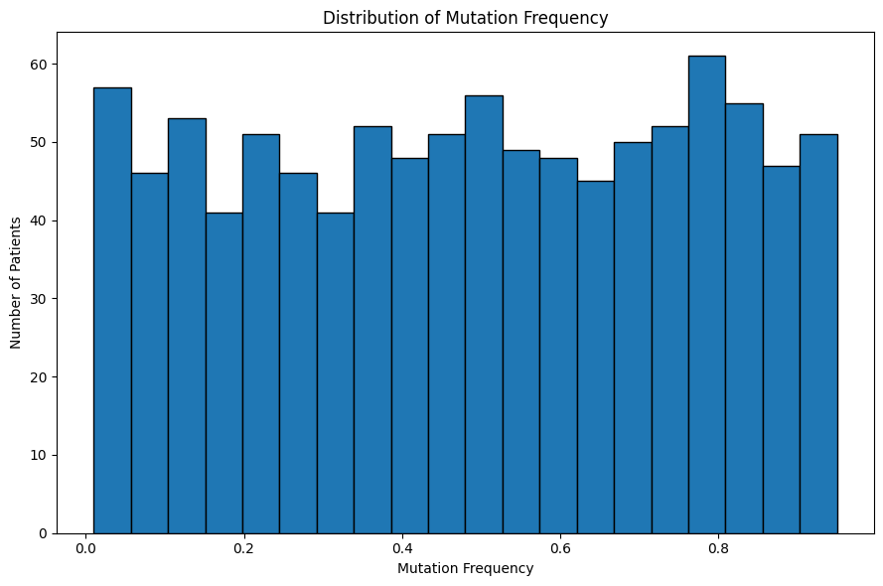
Data Visualization

Slide 15
Histogram Plot
Key insight: The histogram shows the frequency distribution of a numerical cancer-related feature. It helps identify the center, spread, concentration and potential extreme values in the synthetic dataset.

Slide 16
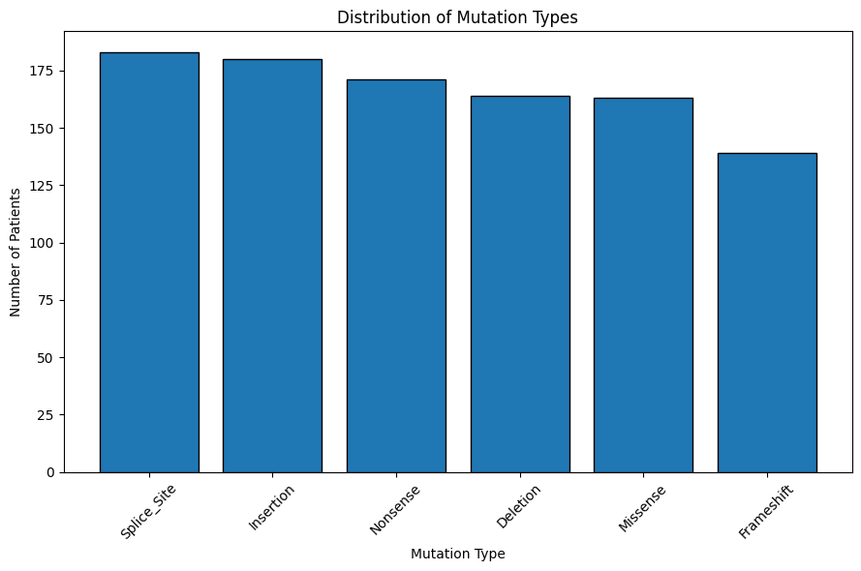
Data Visualization

Slide 17
Bar Chart Plot
The bar chart provides a categorical comparison of mutation frequencies, allowing us to identify which genes or mutation types are most represented in the synthetic dataset. Large differences between categories can also highlight potential class imbalance that should be considered during model development.

Slide 18
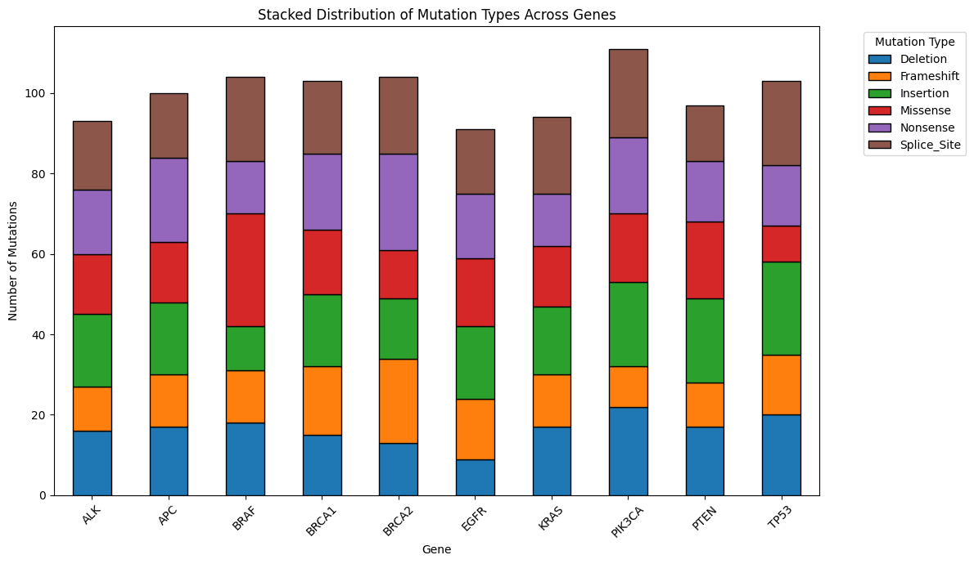
Data Visualization

Slide 19
Stacked Bar Chart Plot
Key Insight: The stacked bar chart shows the total number of mutation records for each gene while simultaneously displaying the contribution of individual mutation types. It provides a compact view of the gene–mutation relationship and helps identify differences in mutation composition across genes.

Slide 20
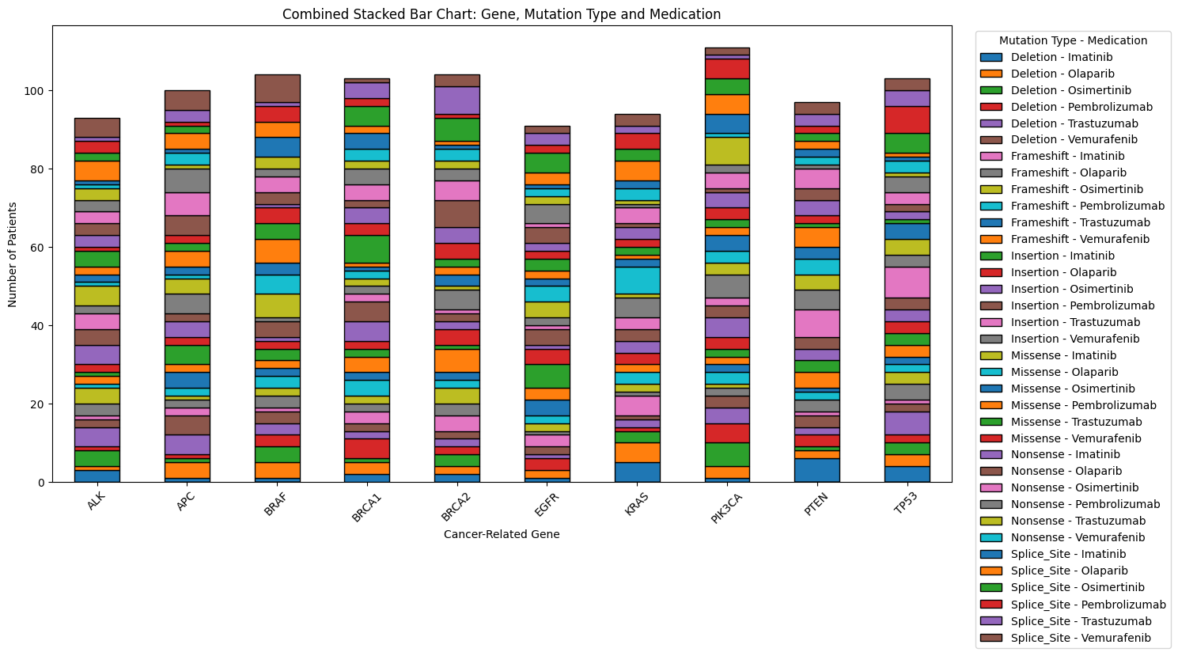
Data Visualization

Slide 21
Combined Stacked Bar Chart Plot
The combined stacked bar chart provides a multi-dimensional view of the synthetic dataset:
Gene → Mutation Type → Medication
The total height of each bar represents the number of records for a gene, while each segment represents a particular medication–mutation-type combination.
Key insight: This visualization can reveal differences in the composition of mutation and treatment categories across genes and is useful during exploratory data analysis.

Slide 22
Key Insights
Mutation patterns: Gene and mutation-type distributions reveal the structure and diversity of the synthetic cancer dataset.
Feature relationships: Stacked bar charts help compare mutation types across genes and treatment categories.
Deep-learning capability: A neural network can learn nonlinear patterns from encoded genomic features for multiclass classification.
Prediction output: The model produces probabilities for multiple medication categories and selects the highest-probability class.
Evaluation is essential: Accuracy alone is insufficient; precision, recall, F1-score and confusion matrices provide a more complete assessment.

Slide 23
Key Insights
Class imbalance matters: Uneven representation of treatment classes can bias model performance and should be investigated.
Synthetic-data limitation: Results from randomly generated data demonstrate the workflow but do not establish real mutation–drug relationships.
Clinical translation: Real-world use requires validated patient data, treatment-response outcomes, external validation, interpretability and oncologist oversight.
Future direction: Integrating gene expression, copy-number alterations, clinical features and biologically informed embeddings could create a more robust research model.

Slide 24
Applications
A validated version of this type of computational framework could potentially support research in:
Precision oncology
Drug-response modeling
Genomic medicine
Cancer biomarker analysis
Treatment-response prediction
Clinical decision-support research

Slide 25
Limitations
There are several important limitations.
First, the dataset used here is synthetic and does not represent real patient outcomes.
Second, randomly generated medication labels do not establish genuine biological relationships between mutations and treatment response.
Third, real cancer treatment decisions depend on many factors, including cancer type, stage, pathology, molecular profile, previous treatments and patient-specific clinical factors.
Therefore, this project should be considered an educational and computational prototype, not a clinical treatment recommendation system.

Slide 26
Future Work
The next stage would be to replace the synthetic data with properly curated and ethically sourced cancer genomics datasets containing validated treatment-response information.
Additional features such as gene expression, copy-number alterations and relevant clinical information could also be incorporated.
More advanced models, including embedding-based neural networks and transformer architectures, could be evaluated.
Model explainability techniques such as SHAP could also be used to investigate which genomic features influence predictions.
External validation would be essential before any clinical application.

Slide 27
Conclusion
To conclude, this project demonstrates an end-to-end deep-learning workflow for personalized cancer medication prediction.
The workflow includes:
Synthetic Data Generation → Data Preprocessing → Exploratory Analysis → Feature Encoding → Deep Learning → Prediction → Evaluation
The project demonstrates how artificial intelligence can be applied to genomic data analysis while also highlighting the importance of data quality, validation, interpretability and clinical safety.
Key insight: This visualization can reveal differences in the composition of mutation and treatment categories across genes and is useful during exploratory data analysis.

